Slide 1
2FA AUTHENTICATION
Session Hijacking • Hashing & Forgotten-PIN Recovery • Where Hashing Meets Blockchain

Slide 2
The Problem
Two loopholes in an otherwise strong 2FA system
Session Hijacking
Forgotten 2FA PIN
An attacker steals a valid session ID after a real login and reuses it to impersonate the user — no password or PIN needed again.
Attack paths: session sniffing, XSS, session fixation, infostealer malware.
Impact: full account takeover that bypasses login controls entirely.
A hashed PIN can never be looked up and read back — not even by admins — so a forgotten PIN can lock out a legitimate user.
The system must verify identity through an independent channel, not the forgotten secret itself.
Core tension: recover access for the owner without opening a shortcut for an attacker.
2

Slide 3

Research
Grounding the solution: how 2FA, hashing, and hash-chains actually work
What makes up 2FA?
Hashing, concretely
Same idea, in blockchain
Something you KNOW
password, PIN, passphrase
A one-way function: PIN in → fixed-length digest out. Same input always gives the same hash; there's no reverse operation.
Only the digest is stored. Login checks 'does this input hash to the stored value?' — it never recovers the original.
Slow, salted algorithms (bcrypt, Argon2) resist brute-force guessing even if the database leaks.
A simple blockchain is a chain of blocks, and each block stores the hash of the block before it.
Change one old record and its hash changes — breaking every link after it, so tampering is instantly visible.
Companies (e.g. IBM supply chain, Coinbase/exchange ledgers, DocuSign) reuse this hash-chaining idea for tamper-evident logs, not just currency.
Something you HAVE
phone, token, passkey
Something you ARE
fingerprint, face, voice
2FA = exactly two of these three factors (a specific case of MFA).
3

Slide 4
Proposed Solution
A layered defense for sessions, paired with a controlled recovery path for PINs
Session Hijacking Defense
Forgot-PIN Recovery
1
Encrypt traffic: HTTPS/TLS, HSTS, Secure/HttpOnly cookies
1
One-time, time-limited OTP to verified phone/email
2
Harden sessions: ID regeneration, short timeouts, device binding
2
PIN stored hashed (bcrypt/Argon2) — reset, never retrieved
3
Require MFA for sensitive systems and high-risk actions
3
Rate limits on PIN attempts and OTP requests
4
Train users: safe networks, phishing awareness, logging out
4
Backup codes as a fallback when phone/email is unreachable
5
Monitor continuously: anomaly detection → auto-terminate + alert
5
After reset: invalidate other sessions, notify user, log the event
4

Slide 5
Technology Stack
Each tool chosen for a specific security or usability requirement
Area | Technology | Why
Session hijacking | TLS/HSTS, Secure/HttpOnly cookies | Protect traffic; restrict unsafe cookie access
Session hijacking | Regeneration, timeouts, token binding | Reduce replay & exposure of active tokens
Session hijacking | Monitoring + incident response | Detect anomalies, terminate compromised sessions
Forgot PIN | React | Componentized, multi-step recovery UI
Forgot PIN | Django + DRF | Secure REST endpoints for auth/recovery
Forgot PIN | PostgreSQL | Relational integrity: users, OTPs, backup codes, audit log
Forgot PIN | Redis | TTL-based OTP expiry & rate-limit counters
Forgot PIN | bcrypt / Argon2 | Slow, purpose-built credential hashing
5

Slide 6





Architecture: Forgot-PIN Flow
React recovery UI → Django REST API → OTP/hash verification → reset
User selects
“Forgot PIN?”
OTP sent to
verified phone/email
User submits OTP
expiry + attempt checks
PIN-reset token
issued
New PIN created
→ hashed & stored
Other sessions
invalidated + audit log
Stack: PostgreSQL stores users, OTP requests, backup codes, and audit records. Redis backs short-lived OTP TTLs and rate-limit counters. SMS/email gateways deliver OTPs and reset alerts.
Session hijacking layer runs in parallel: authenticate → create session → TLS + Secure/HttpOnly + regeneration + timeout + binding → monitor for anomalies → invalidate & alert.
6

Slide 7
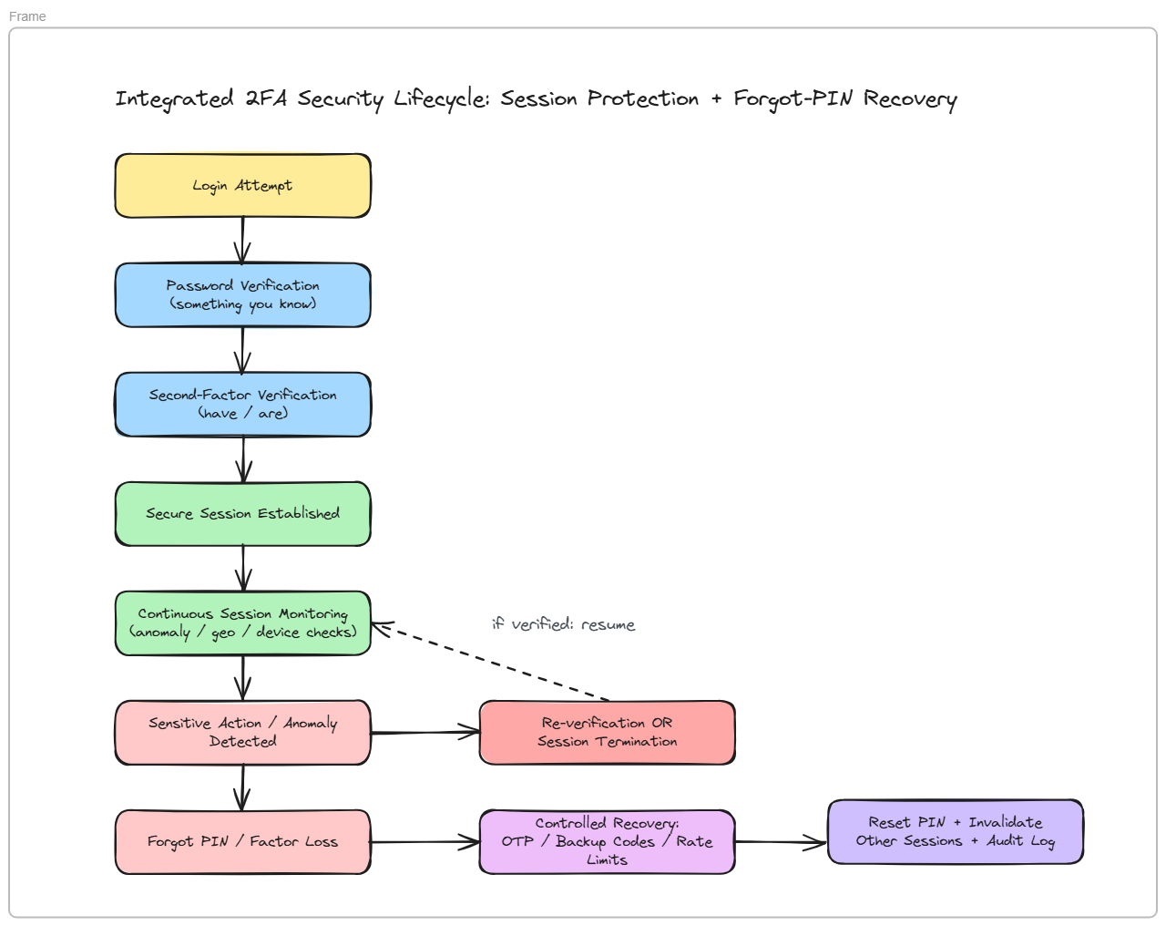

Slide 8


Challenges & Impact
Trade-offs faced, and what the solution changes for users and the business
Challenges
Impact
No true 'undo': hashing is deliberately one-way, so recovery always means resetting, not retrieving.
Every new recovery channel (OTP, backup codes) is itself a new attack surface that needs rate limiting.
Balancing security friction against usability — too strict and users abandon the flow or resort to unsafe workarounds.
Session controls (timeouts, binding) must not be so aggressive they log out legitimate users constantly.
Users get a self-service recovery path — no support ticket needed to regain access.
No hidden backdoor exists: even a compromised database can't hand an attacker a usable PIN.
Stolen session tokens are caught faster and shut down automatically, shrinking the window of misuse.
Audit logs give the team visibility into every recovery and session event for post-incident review.
7

Slide 9



Our Team Learning
From problem identification to a presentable, defensible design
New services, new failure modes
Reuse open standards
Design recovery with authentication
Every security feature (OTP, hashing, monitoring) adds its own dependency and its own way to break.
TOTP and WebAuthn exist so teams don't have to re-invent cryptographic trust from scratch.
Recovery can't be bolted on later — it needs the same security mindset as login itself.
Usability is part of security
Diagram before you build
Rollouts need a plan
Excessive friction pushes users toward unsafe workarounds, which defeats the control.
Mapping the architecture first surfaced trade-offs and failure points early, not after implementation.
Large auth changes require careful communication and support, not just a code deploy.

